Slide 1
Data Driven KPI’s

Slide 2
Charlene John
Head of Student Centre and Customer Experience
James Newman-Shah
Student Centre Manager

Slide 3




Slide 4
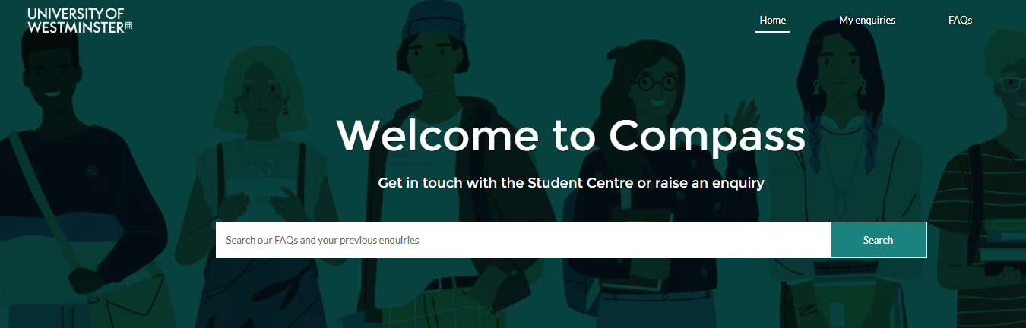


Slide 5
Perception

Slide 6


Slide 7



Slide 8
‘Staff will never accept Targets/KPI’s – It’s micromanagement’
‘We know that X does less than anybody, it is what it is’
‘Enrolment is our busiest time, so SLA’s go out the window’

Slide 9

2024

Slide 10
Entered out peak period with over 5000 on our dashboard
2 Week Response Times
Stressed and Resentful Staff
Damaged Reputation

Slide 11
What is a KPI?
KPI’s give a holistic view of the performance of different functions in your organisation
Significant measures of performance and progress
Useful for stakeholders and cross-departmental collaboration

Slide 12
Reflect, review and look for oppurtunies

Slide 13
15,000 duplicate enquiries
2 Week Response Times
32% of digital engagement was live-chat

Slide 14
KPI – 1 45% of digital engagement to be live-chat

Slide 15
Removing the Email
Stakeholder Support
Effective rota management

Slide 16
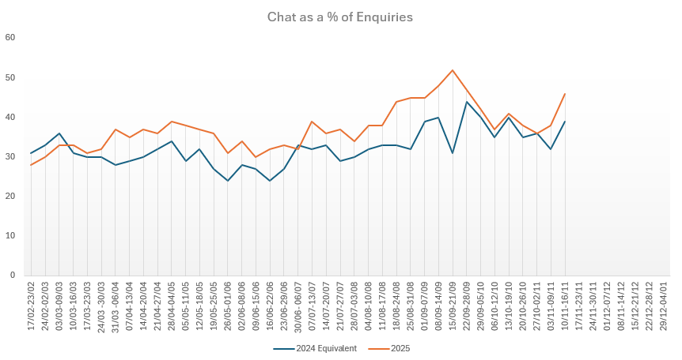
41% from mid July

Slide 17
2nd Line Delays
Duplicates
50% Answered at 1st Line

Slide 18
KPI – 2 67.5% of enquiries answered at 1st Line

Slide 19
Effective Training
Stakeholder Support
Registering desk queries

Slide 20
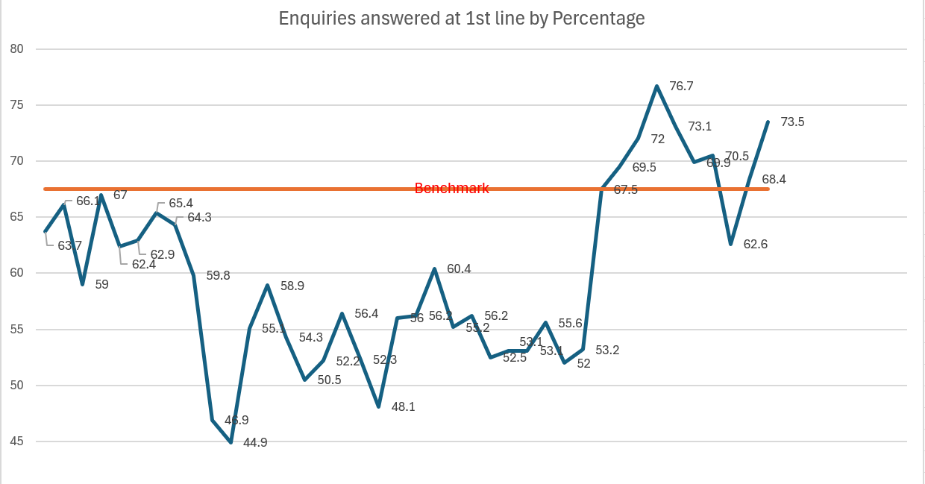

59% from mid July

Slide 21
The ‘Controversial’ one

Slide 22
Over 5k of enquiries
2 Week Response Times
Majority of enquiries answered by a minority of staff

Slide 23
KPI – 2 Staff to answer 4.5 enquiries per hour

Slide 24
Equity
Training Opportunities/Feedback
25% growth in enquiries answered
Trends and Patterns

Slide 25

Selling the idea
Away Day’s
1 to 1’s
Webinars

Slide 26
Post enrolment 2025

Slide 27
30% Growth in Enquiries answered
SLA Broken Twice & returned within 12 hours

Slide 28
Reflect & Adapt
Data doesn’t stop at Enrolment
Culture change
Feedback, feedback, feedback

Slide 29
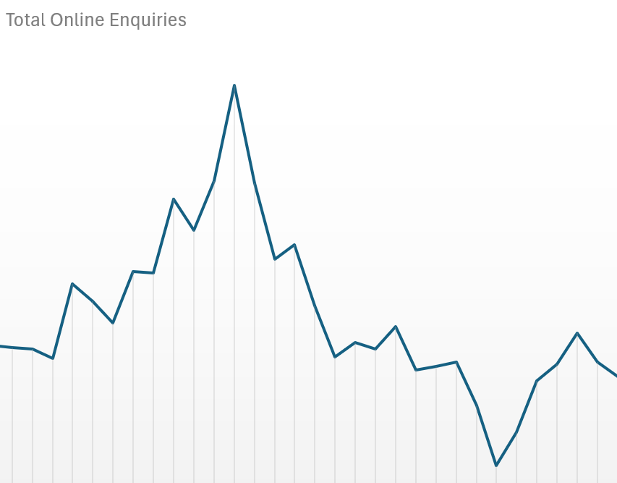
Planning & Prioritising

Slide 30
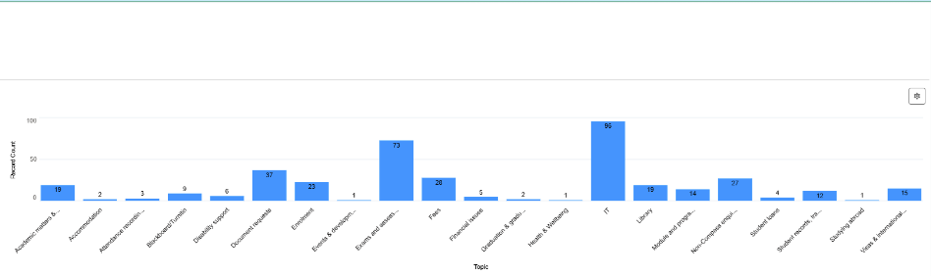
Training & INsights

Slide 31
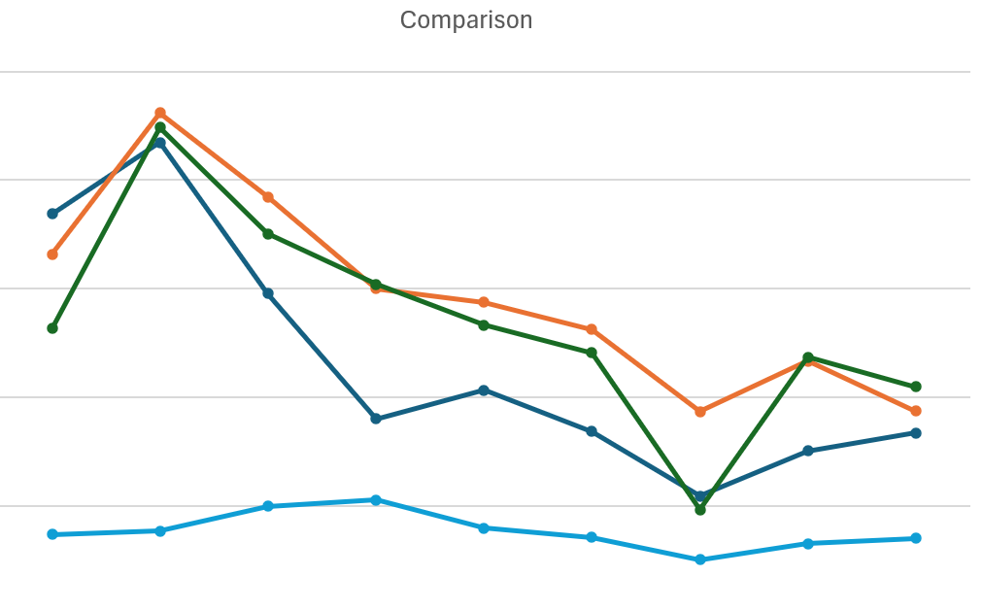
Effective Rota’s

Slide 32


Slide 33


