Slide 1

Using qualitative data to enhance library accessibility
Chloe Price-Lonsdale, Library User Experience Design and Development Group
Notes:
The User Experience Design and Development group is a made up of staff from across the Customer Services, Acquisitions and Content Delivery, and Teaching and Engagement (liaison/subject librarians) teams with the aim of identifying opportunities for service development, using user experience techniques.

Slide 2

Contents
 | Contents
01 | Project background
02 | Ethics approval
03 | Data analysis
04 | Ideation
05 | Project outcomes
06 | Reflections
2

Slide 3
Project background
Received feedback from other services that some students felt uncomfortable using the library.
BUT – not enough information for us to know how to resolve this!
Semi-structured interviews
  What are the main barriers/difficulties in the library? ​
  If you could change one thing about the library, what would you change?​
  What is working well?​
  What do you think makes a good study environment? ​
  What do you think makes a good online library?​
  Where would you look to find information on accessibility services? What kinds of information would be useful?​
  Is there anything else you’d like to tell us?
Notes:
We formulated the questions as a group, including the physical space but also our online services. It was really important for questions to be open to give students the opportunity to talk about what matters to them, rather than limiting ourselves to our own perspectives.

Slide 4
Ethics approval
  Why?
  What was involved:
    Risk assessment
    Data management plan
    Consent forms and information packs
Notes:
Ethics approval should be obtained whenever you are working with human participants. In our case, it was particularly important due to the potentially sensitive nature of the information students might share with us. Particular experiences/diagnoses could make students identifiable. We wanted to ensure we were treating our participants with respect and integrity.
Emotional risk when discussing difficult experiences.
Data management – secure storage of anonymised data with a timescale for deletion.
We recruited 14 students, who were recompensed for their time with a £20 online shopping voucher.

Slide 5
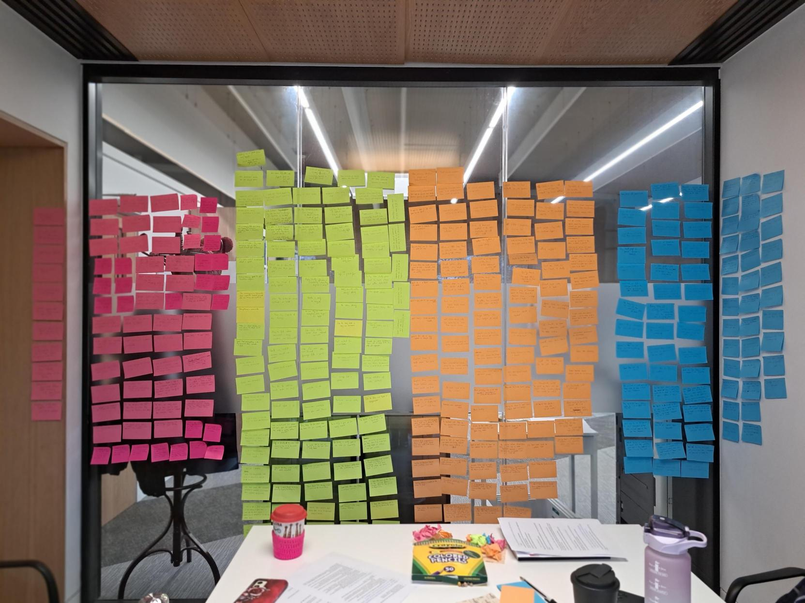
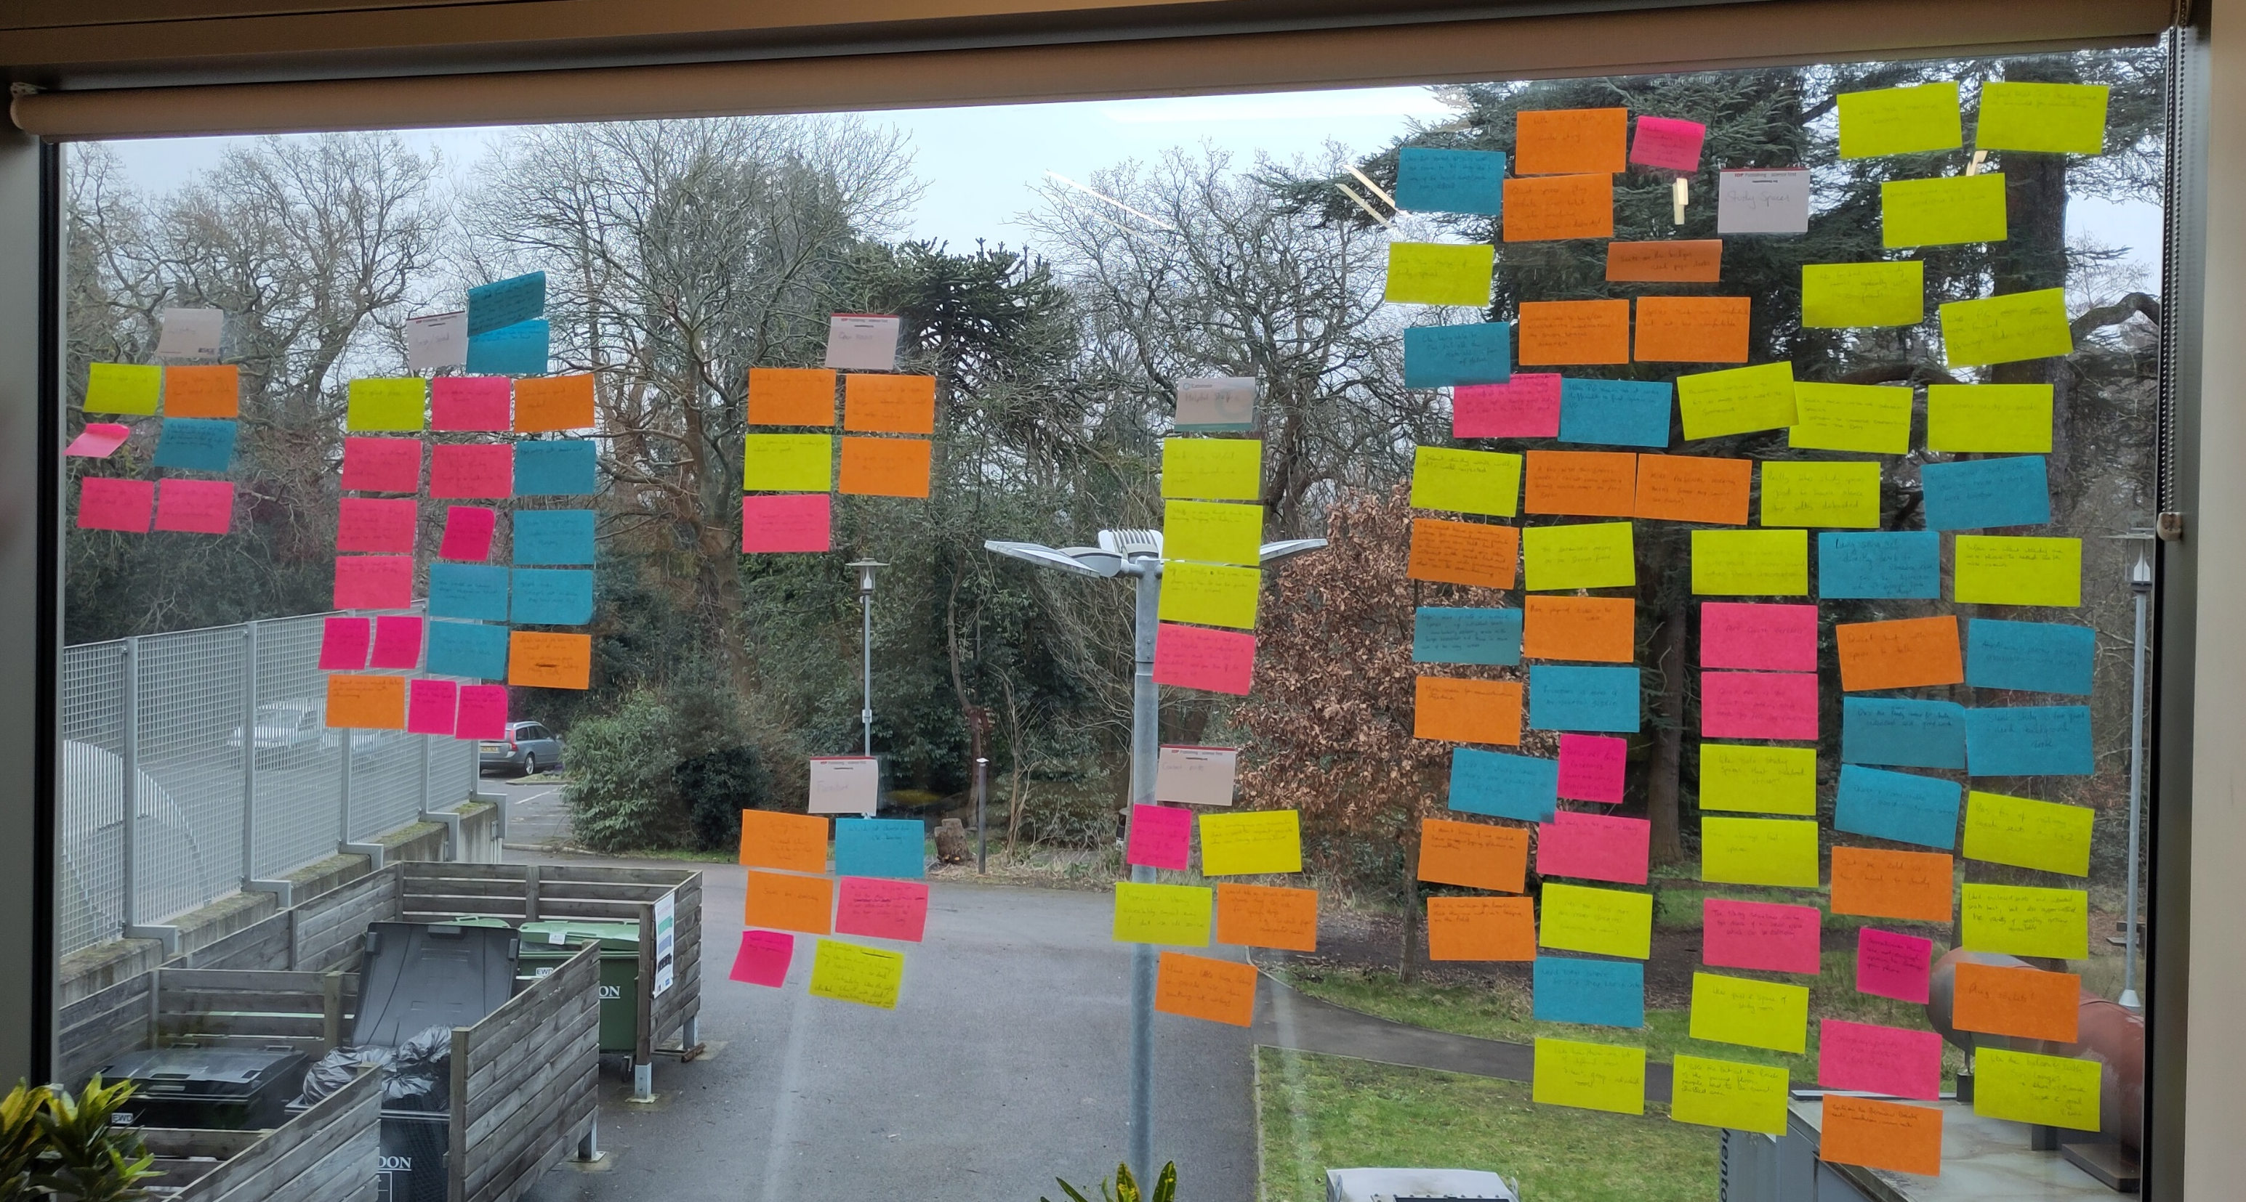
Data analysis
Affinity mapping – ‘A Handbook of User Experience Research & Design in Libraries’ (Andy Priestner, 2021)
Key findings:
  Study space – noise levels, furniture preferences
  Collection discovery – online and print
  Information on accessibility – mix of formats
  Students appreciate being asked!
Notes:
Affinity mapping – start with identifying problems, praise, suggestions and observations, then group across these categories into themes.
Key findings:
Study space – distractions in silent study, or it is too quiet! Group study can get too noisy to concentrate. Students prefer more enclosed seating, other suggestions of ergonomic equipment that would help them.
Collection – flexibility of online resources is really helpful, though reading results/inconsistent tools can be a challenge. Main issue is moving from the catalogue to finding books on the shelves.
Students prefer information on accessibility to be centralised – some like in-person help, others want to be self-sufficient and learn in advance.

Slide 6
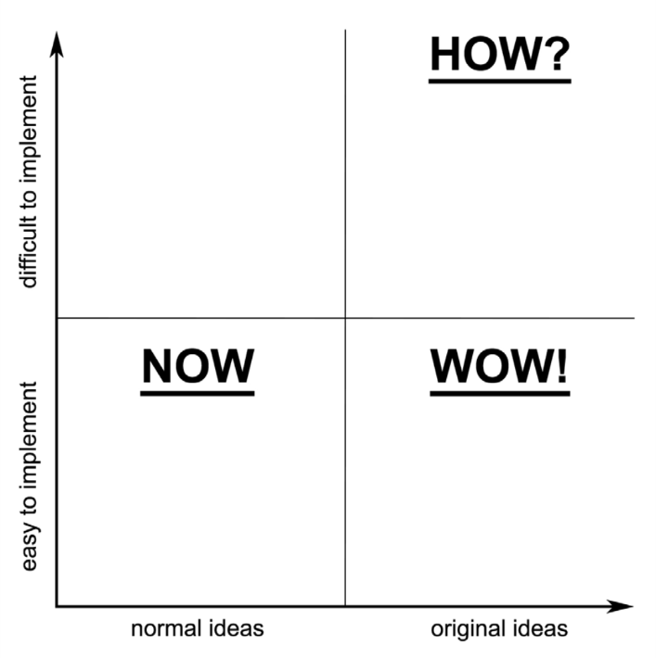
Ideation
Turning data into actions
Start big!
Cross-team expertise
Notes:
Start creatively and narrow down later.
How, now, wow framework helps identify what is achievable.

Slide 7
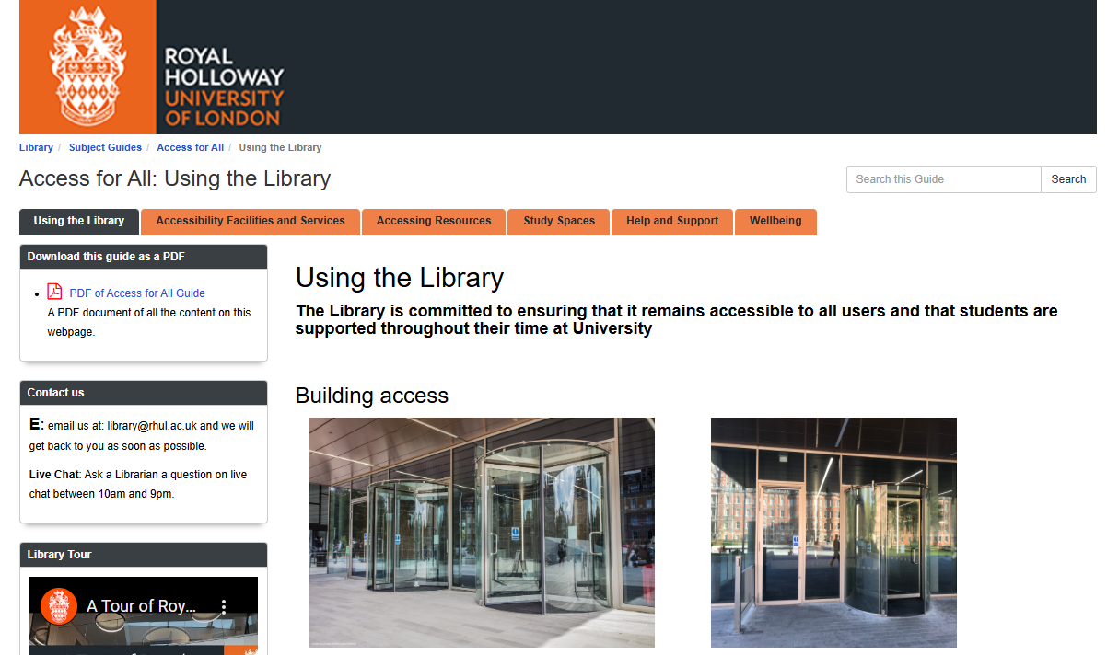
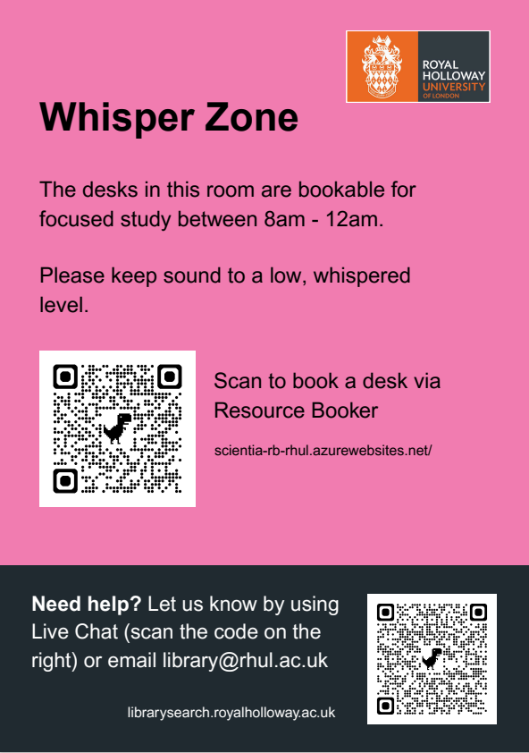
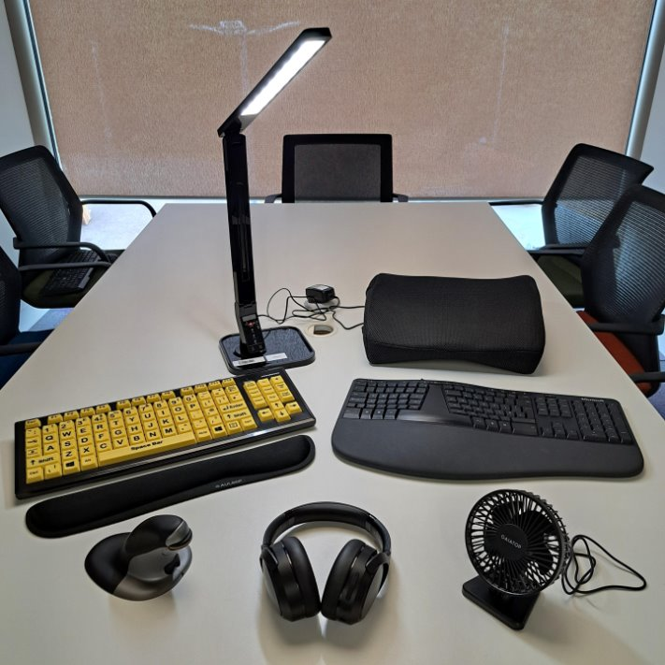
Project outcomes
Creation of a ‘Whisper Zone’ with bookable desks
Updated our ‘Access for All’ online guide with new information including parking, study spaces
Added links to accessibility guidance or statements for e-resource platforms (where available) on our databases page
Expanded our range of loanable equipment
  E.g. noise-cancelling headphones, fans, cushions
Programme of bookable tours
Potential future changes
Notes:
Potential future changes – ergonomic provision in whisper zone, and improved information on catalogue. With student-derived data, library management are taking these ideas into digital/budget planning.

Slide 8
Reflections
  Qualitative data is essential to know what will actually benefit students
  You do not need lots of participants!
  Use academic research ethics frameworks
  UX works best as a collaborative project
  The process itself is important for students
“I think the library’s Access For All resource is incredibly useful, having such an open catalogue of all the available access arrangements and resources is genuinely incredible and should be the baseline of support that we provide nationwide!”
Blog post on Students’ Union website written by Student Leader
“[Being interviewed] makes me think – oh, you actually care!”
Interview participant
Notes:
Cannot know what students need without talking to them – quote.
To use a cliché, it is case of quality over quantity.
What helps a couple of people will help many others – inclusivity by design – changes not just for students registered with Disability and Neurodiversity.
Asking the students for their input in a rich, meaningful way makes them feel heard and increases their feelings of agency and belonging at university. Especially important for those from underserved backgrounds.

Slide 9
Thank You!
library@rhul.ac.uk
Notes:
Same as the slide before but without an image

