Slide 2
Leveraging data analytics in the University of Hertfordshire’s LRCs
Pete Hanna
User Experience Manager

Slide 3

Aims for today
Sharing our journey in developing services through data
Explore some specific examples
Encourage you to think about the different data you have and how you can use it
All feedback, questions and suggestions are welcome

Slide 4
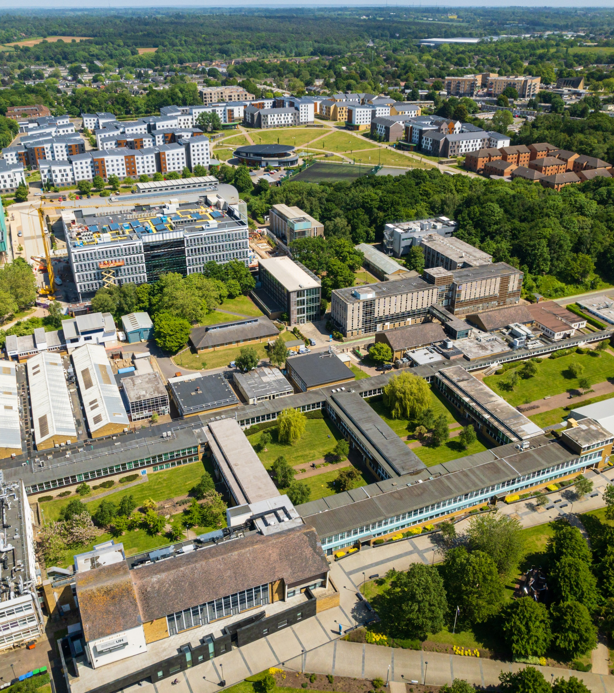
University of Hertfordshire (UH)
Post 92 University
Based in Hatfield with 2 main campuses
Over 3,000 staff
35,000 students from 110 countries
Our schools of study:
Hertfordshire Business School
School of Health Medicine and Life Science
School of Creative Arts
School of Education
Hertfordshire Law School
School of Physics, Engineering and Computer Science

Slide 5
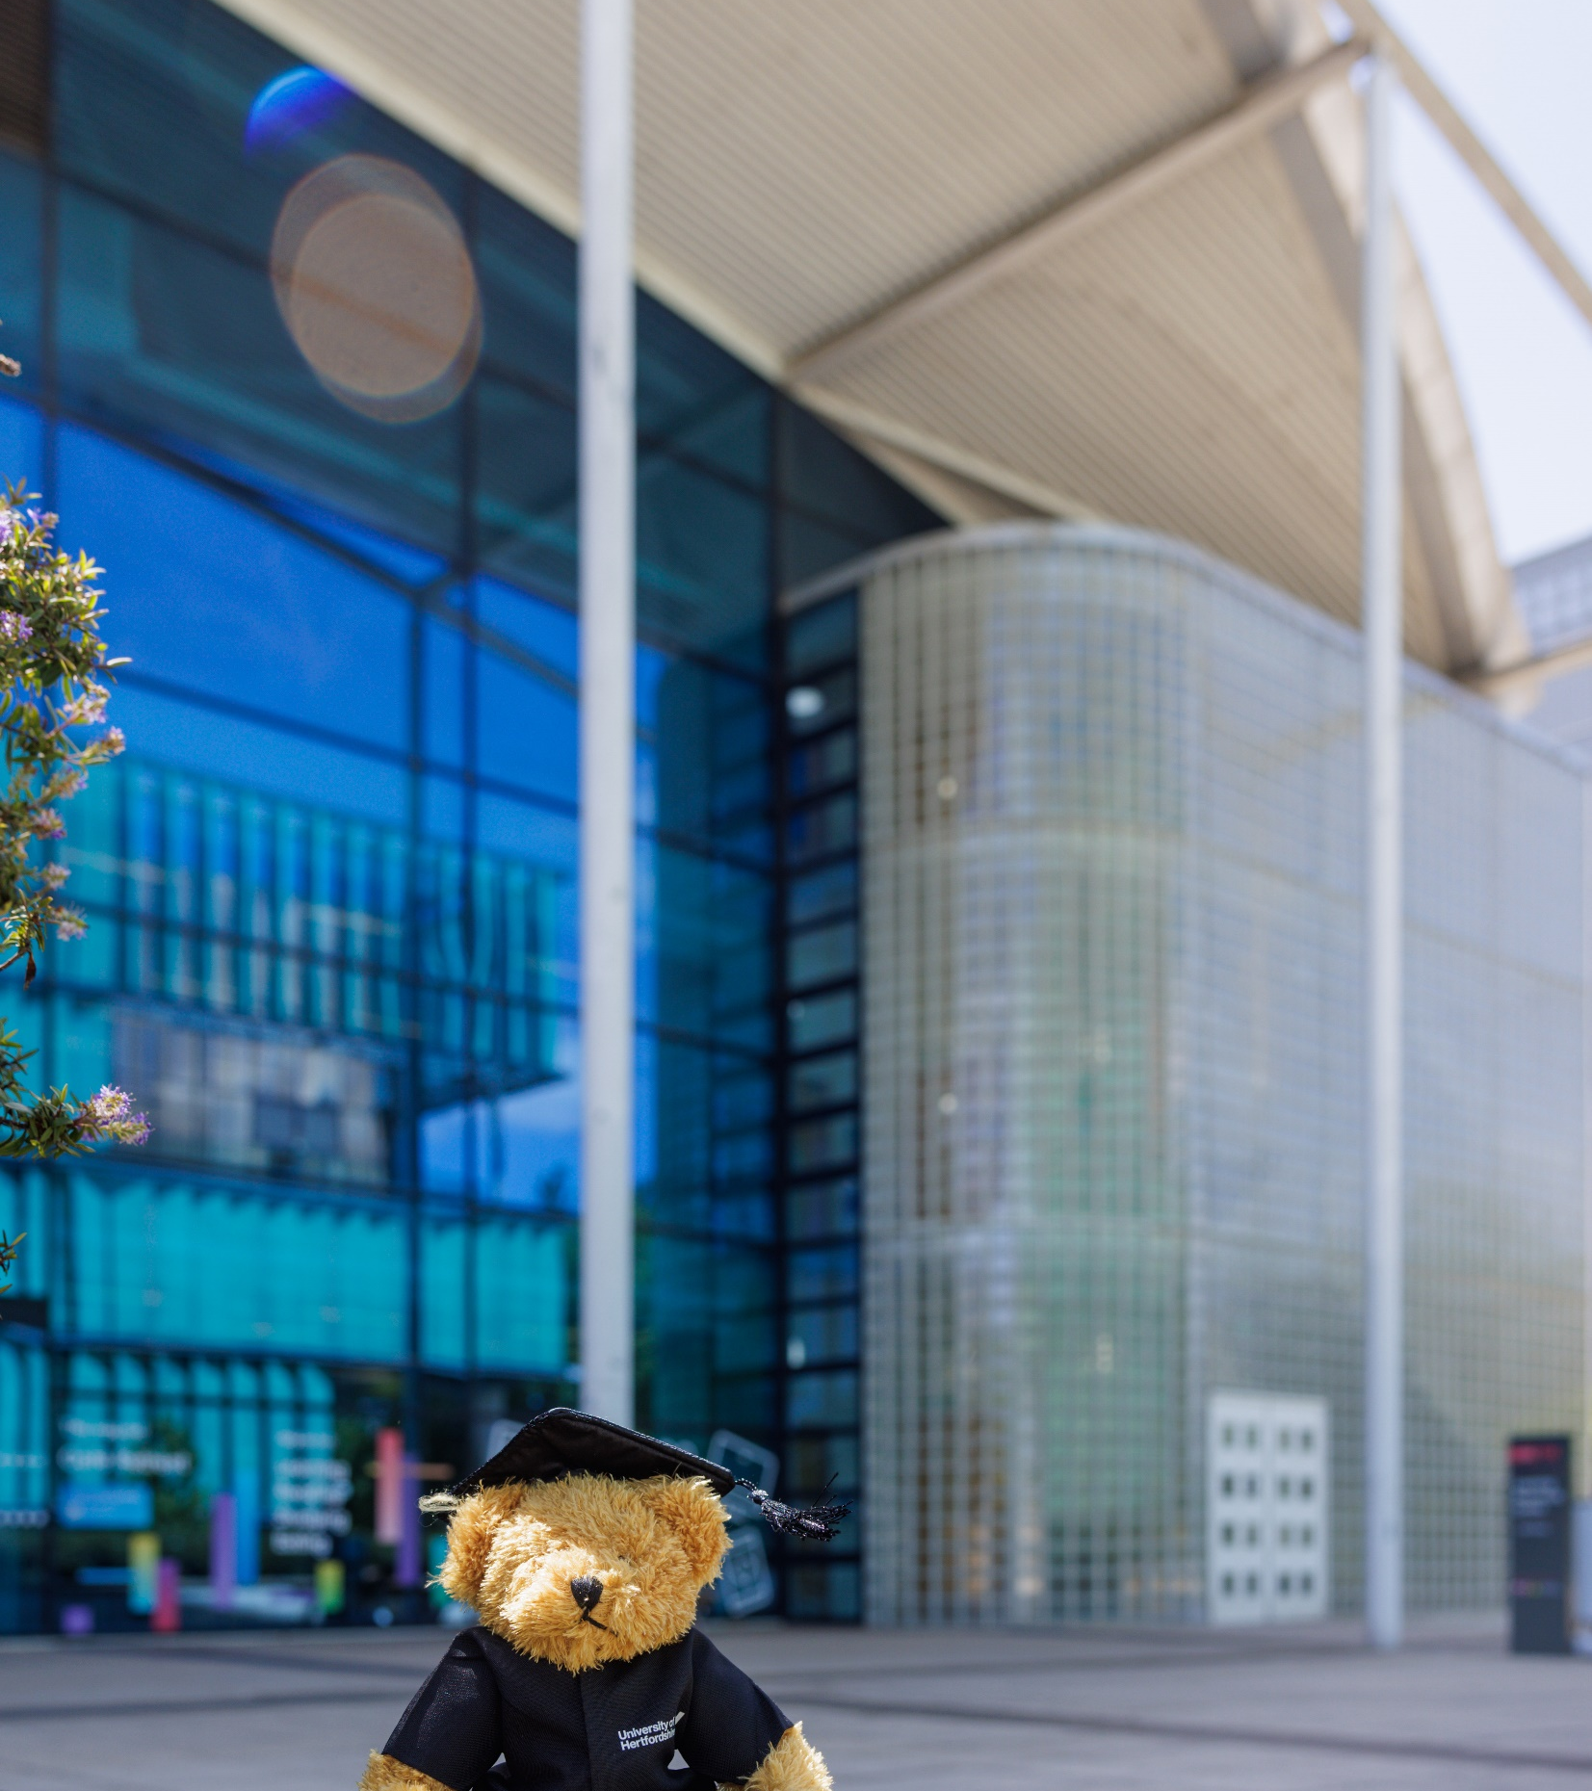
Our LRCs
2 sites, with 1,500 seats each
Open 24 hours, 365 days a year
Community of students, staff and public
Up to 900 people in each LRC
400,000 physical books
1,000 plus pcs, macs and Chromebooks
Silent study, group study and bookable group study options
Teaching rooms and computer labs
Welfare, vending and self-service catering
Cultural, wellbeing and engagement events

Slide 6
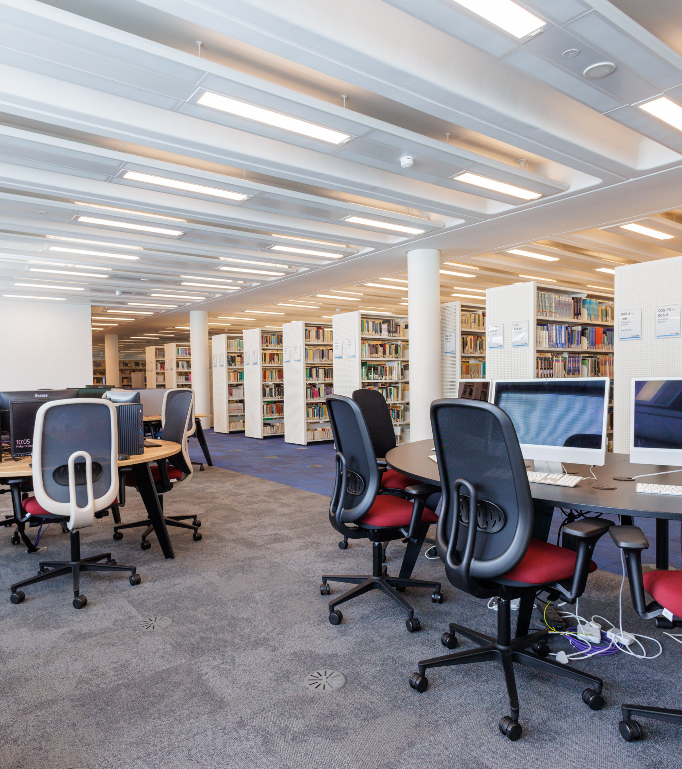
User Experience Manager
Operational responsibility for the LRCs
Chair of governance group
Customer service team
Understanding current student experience
Exploring future needs
Prioritising and delivering developments
And now a print room…

Slide 7
Data in the LRCs
Data types | Includes
External environment | Macro (PESTEL) and sector (compete or collaborate?)
Organisational | Strategic priorities, educational needs, recruitment data, equality and attainment data (KPIs?)
Resources (Capabilities) | Numbers of seats, pcs, staff Services and facilities
Resources (Utilisation) | Book borrowing and usage of eBooks PC, Chromebook and printer usage and network connections Room bookings
People (Attitudinal) | User experience research Complaints, NSS/module feedback, events feedback Social media likes
People (Behavioural) | Footfall data and utilisation surveys User experience observations Service desk information (numbers and types of queries) Security data (incident reports)
Financial | Budgets, Investment funding, costs, income
Estates | Building management system and maintenance logs Timetabling data
The 5 V’s of (big) data
Volume: The sheer size of the data.
Variety: The different types of data.
Velocity: The speed at which data is generated and processed
Veracity: The accuracy and truthfulness of the data.
Value: The utility of the data and its ability to provide benefits

Slide 8
Where did we start?
Drivers for change:
Desire to take action
Ensure we take informed decisions
Need to influence the powers that be
Need to change the narrative
Need for increased efficiency and effectiveness
Fragmented, incomplete and underused:
Book borrowing statistics
Basic entry and exit data
Complaints
NSS data
Module feedback
Paper sign in sheets for visitors
‘Students are all the same’
‘The library is always noisy’
Anon

Slide 9
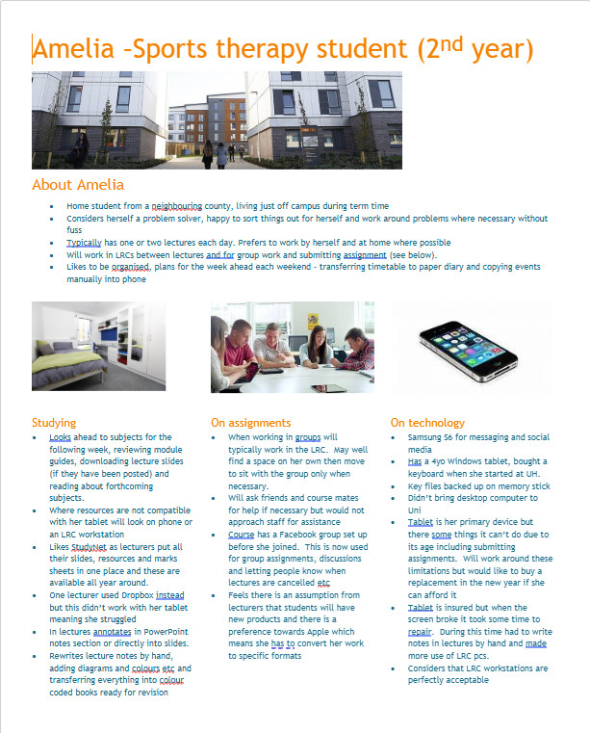
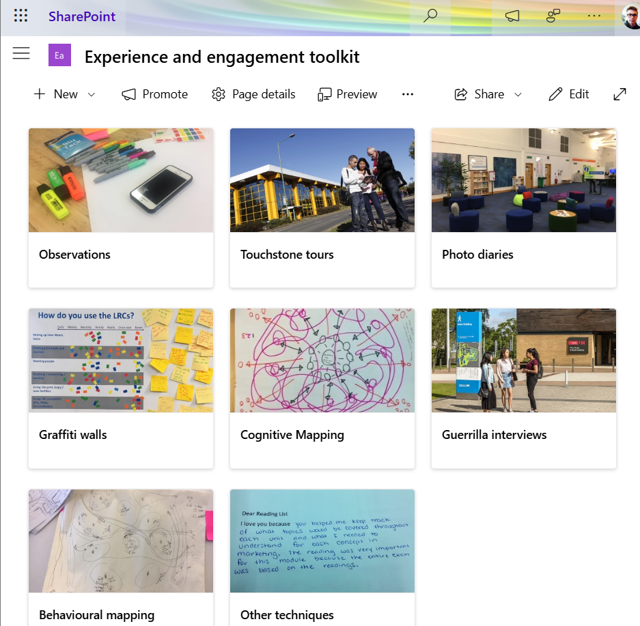
Understanding our students – a first step
Profiling – documenting 30 stories to demonstrate diversity
Adopting a User Experience driven approach
Putting UX stories into context
University student dashboards
Recruitment numbers
Commuting students
Demographic
Retention and attainment data
Equality and diversity
And much more….

Slide 10
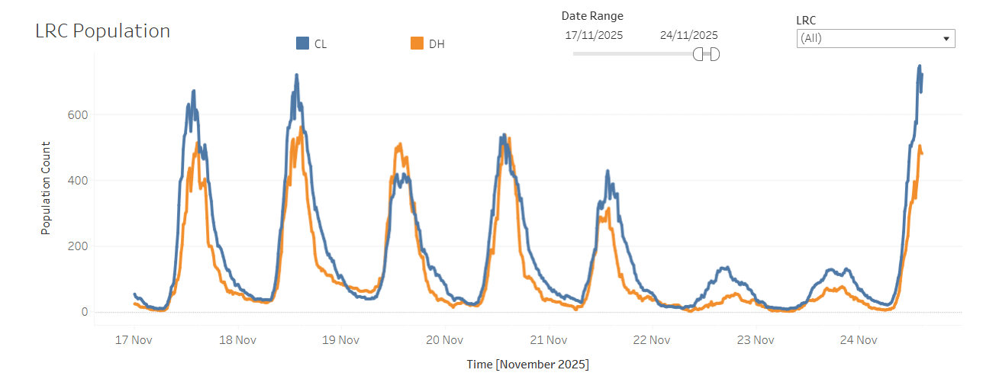
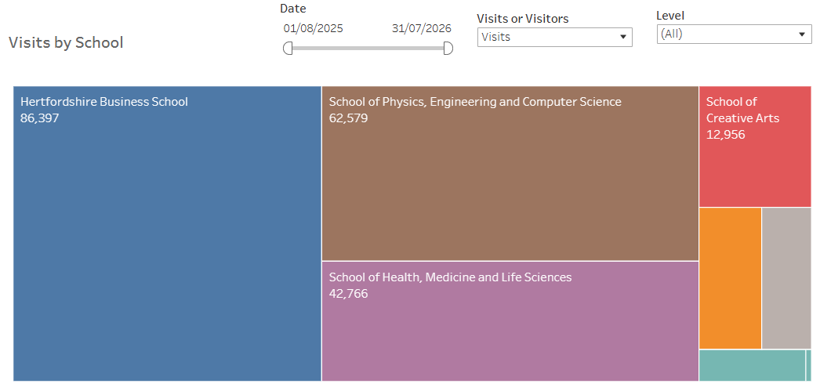
Example 2: Who is using our LRCs
Making data meaningful:
Definitions (visits and visitors)
Sources of error
Verification
User Experience data
Utilisation surveys and head counts
Benefits:
Understanding behaviours and trends
Planning staffing, services and events
Planning and justifying future developments
Links to academic engagement / retention
Proactive user information (mobile app)
Next steps
Correlating timetabling data
Wifi beacons and network connections

Slide 11
Things to think about
Have a vision – but remember Rome wasn’t built in a day
Be pragmatic and agile – seize opportunities
Triangulate – rich user stories can bring hard data to life!
Be curious – remember the five whys
Identify easy wins - prove the concept and shout about it

Slide 12
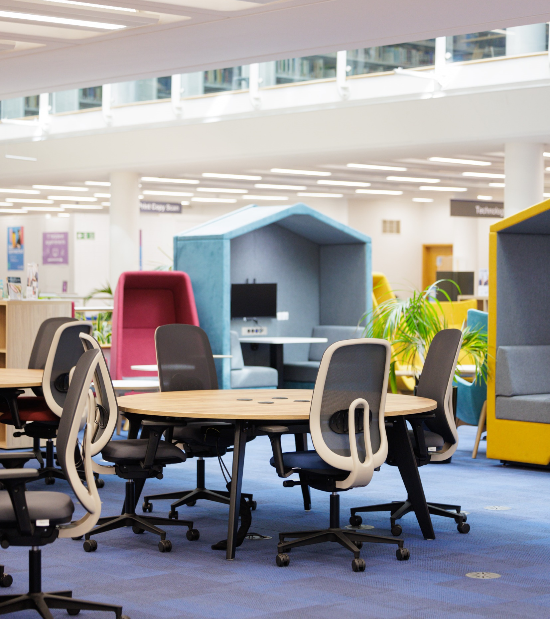
Things to think about
Have a vision
but remember Rome wasn’t built in a day
Be pragmatic and agile
seize opportunities
Triangulate
rich user stories can bring hard data to life!
Be curious
remember the five whys
Identify easy wins
prove the concept and shout about it

Slide 13
Thank you
Email:.p.hanna@herts.ac.uk

Slide 14
Example 3
Image of complex computer system

